Slide 1

Operator and Expression in Java

Slide 2
Introduction
In this section we will learn about operators, there syntax and how to use them etc.
Where operators are symbols that used to perform different operations based onto the types of operator been used
They are different types of operator in Java

Slide 3
Assignment operator
Where it is used to assign value onto variables
Where it is one of most common operator that we use.
We use it in every statement
Int age;
age = 20;

Slide 4
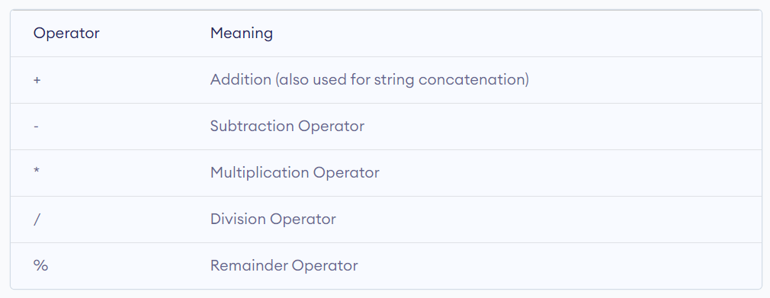
Arithematic Operators
They are used to perform mathematical operations like addition, substraction, multiplication etc.

Slide 5
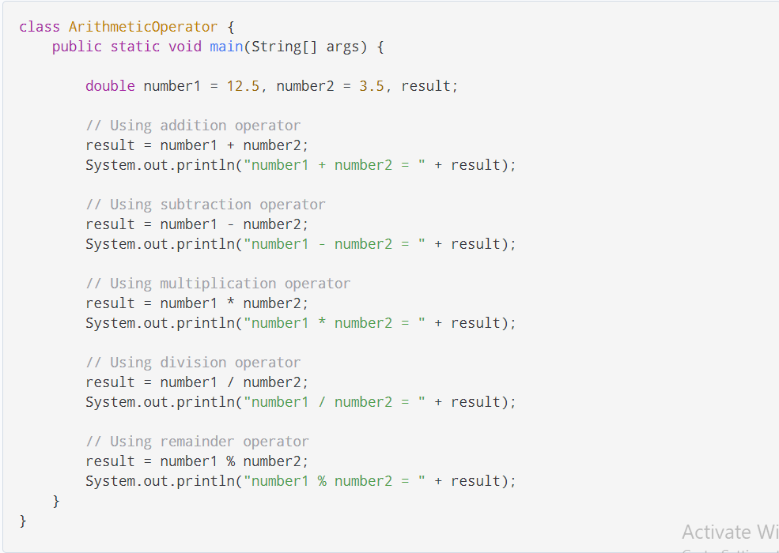

Slide 6
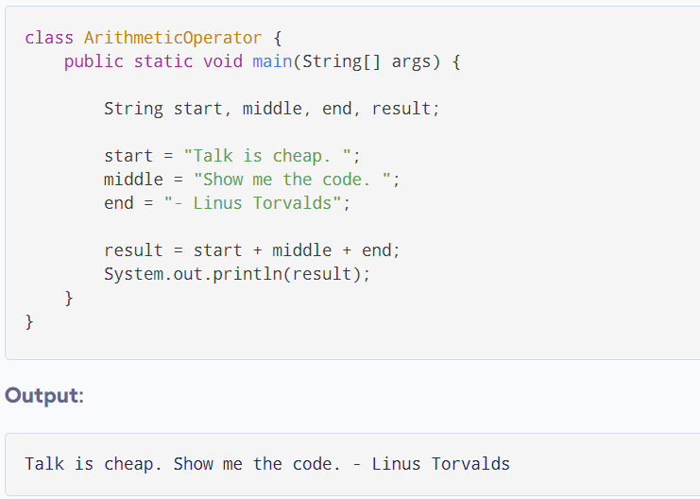
Arithematic Operator to add String

Slide 7
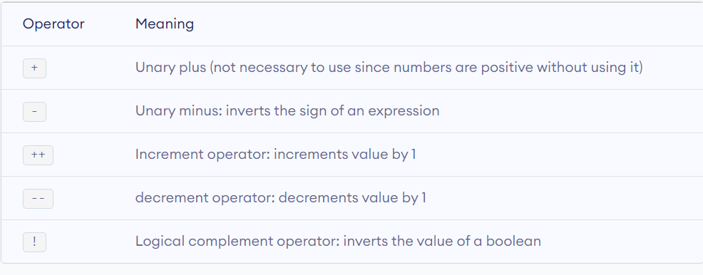
Unary Operator
Unary operators perform operation on only one operand

Slide 8
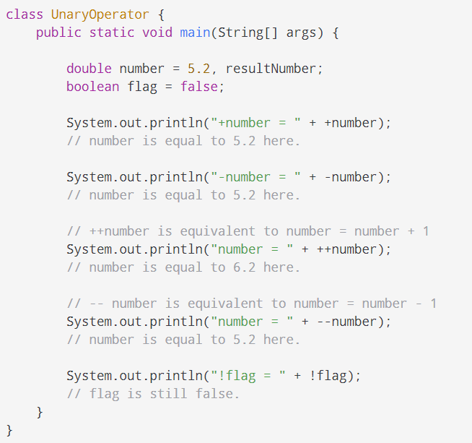

Slide 9
Increment and decrement operators
You can use ++ and – as both prefix and postfix.
Where the ++ increase by 1 and
-- operator will decrease the value of variable by 1
Prefix ++x will first increase the value and then complete the expression
Whereas x++ will first evaluate the expression and then increase by 1

Slide 10
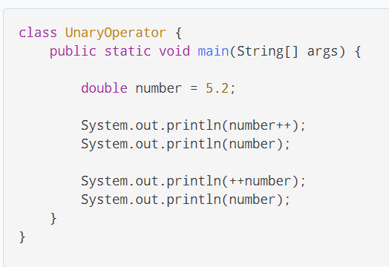
Example

Slide 11
Relational Operators
Where relational operators determine the relationship between two operands
Which will check if an operand is greater than, less than, equal to so onto the other operand.
Depend onto the relationship it will evaluated true or false.

Slide 12
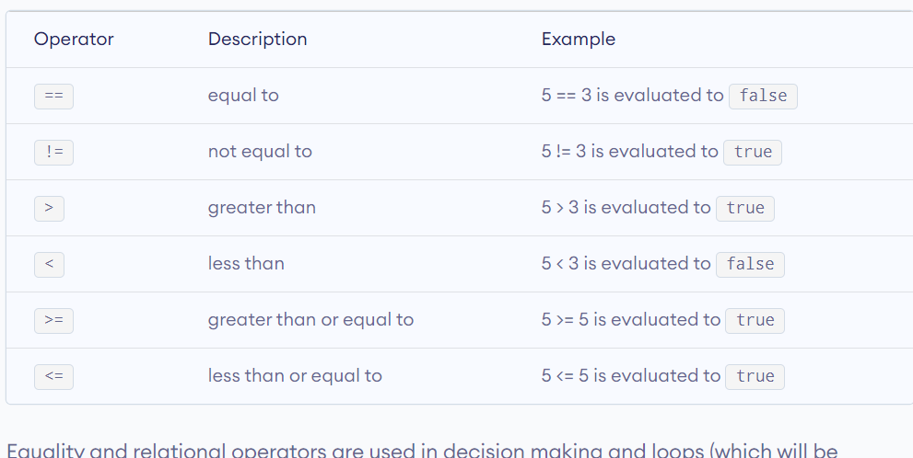

Slide 13
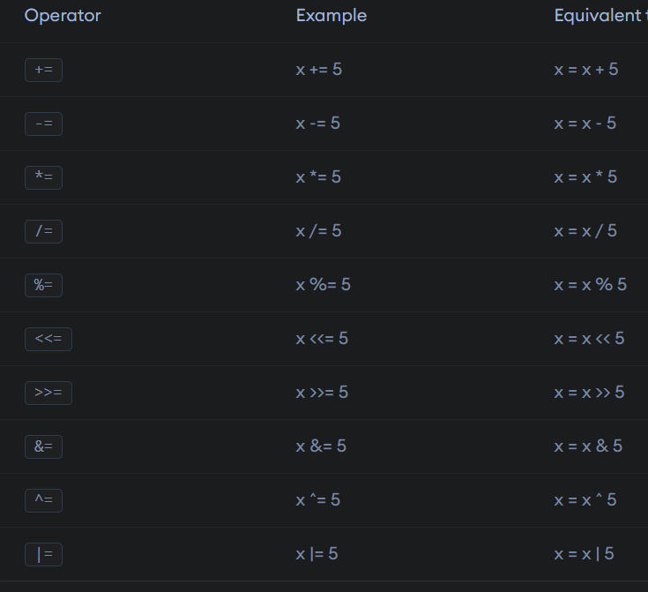

Slide 14
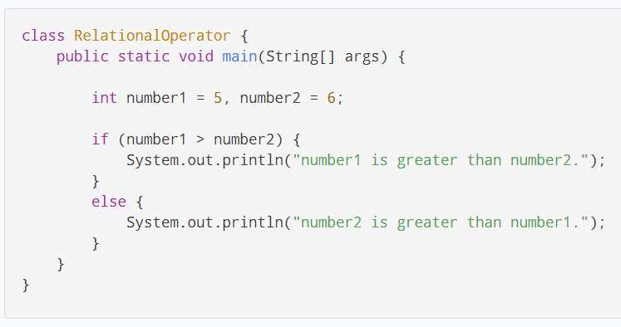
Example

Slide 15
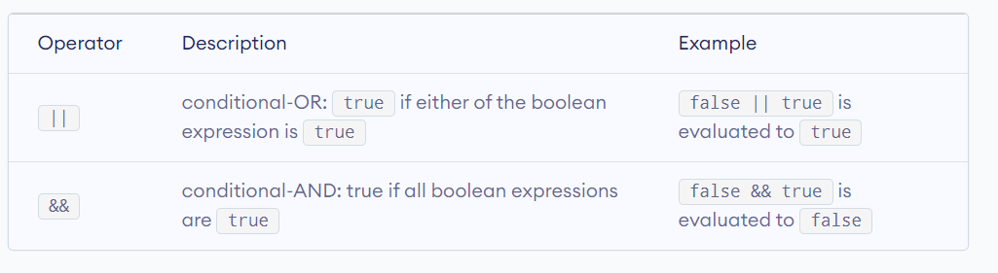
Logical Operators
The logical operators || (conditional-OR) and && (conditional-AND) operate on boolean expressions.

Slide 16
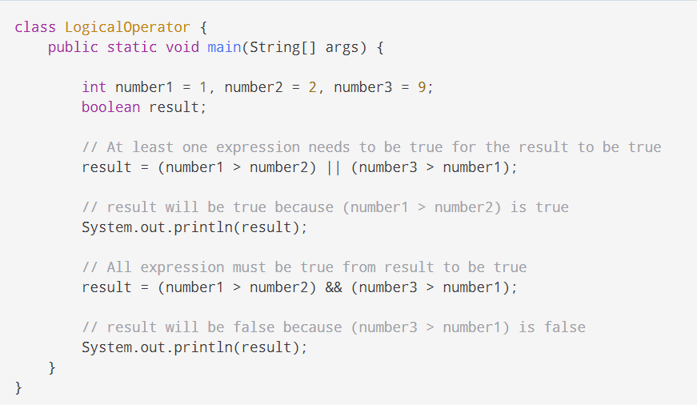
Example

Slide 17

Ternary Operator
The conditional operator or ternary operator ?: is shorthand for the if-then-else statement. The syntax of the conditional operator is:
variable = Expression ? expression1 : expression2
If the Expression is true, expression1 is assigned to the variable.
If the Expression is false, expression2 is assigned to the variable.

Slide 18
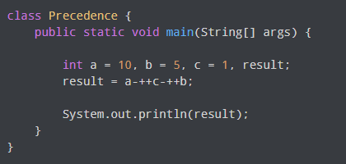

Slide 19
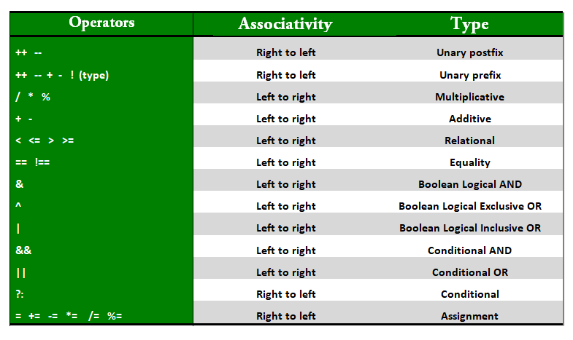

Slide 20

Bitwise Operator
They are used to performing manipulation of individual bits of a number. They can be used with any of the integral types ( char, short, int etc. ).
They are used when performing updates and query operation of Binary indexed tree etc.
The bitwise operator are
Bitwise OR operator ( | )
Bitwise AND operator ( & )
Bitwise XOR operator ( ^ )
Bitwise Complement ( ~ )

Slide 21
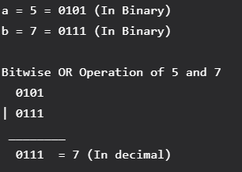
Bitwise OR operator ( | )
This operator is a binary operator, denoted by ‘|’. It returns bit by bit OR of input values, if either of the bits is 1, it gives 1, else it gives 0.

Slide 22
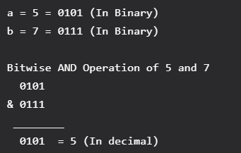
Bitwise AND operator ( & )
This operator is a binary operator, denoted by ‘&’.
It returns bit by bit AND of input values, i.e, if both bits are 1, it gives 1, else it gives 0.

Slide 23
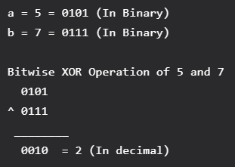
Bitwise XOR operator ( ^ )
This operator is a binary operator, denoted by ‘^’.
It returns bit by bit XOR of input values, i.e, if corresponding bits are different, it gives 1, else it gives 0.

Slide 24
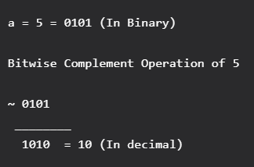
Bitwise complement ( ~ ) Operator
This operator is a unary operator, denoted by ‘~’.
It returns the one’s complement representation of the input value, i.e, with all bits inverted, which means it makes every 0 to 1, and every 1 to 0.

Slide 25
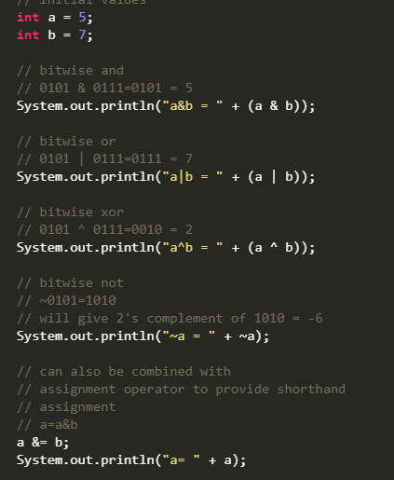
Example

Slide 26
Shift Operators
These operators are used to shift the bits of a number left or right thereby multiplying or dividing the number by two, respectively.
They can be used when we have to multiply or divide a number by two.
number shift_op number_of_places_to_shift;
Types of shift operator
Signed right shift operator
Unsigned right shift operator
Signed left shift operator
Unsigned left shift operator

Slide 27
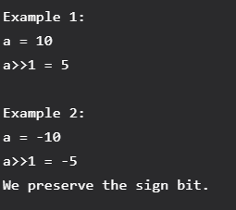
Signed Right shift operator ( >> )
Shifts the bits of the number to the right and fills the voids left with the sign bit (1 in case of negative number and 0 in case of positive number).
The leftmost bit and a depends on the sign of initial number. Similar effect as of dividing the number with some power of two.

Slide 28
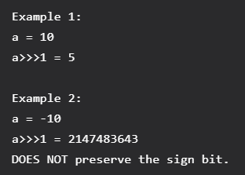
Unsigned right shift operator ( >>> )
Shifts the bits of the number to the right and fills 0 on voids left as a result.
The leftmost bit is set to 0. (>>>) is unsigned-shift; it’ll insert 0. (>>) is signed and will extend the sign bit.

Slide 29
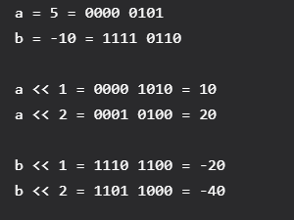
Left shift operator ( << )
Shifts the bits of the number to the left and fills 0 on voids left as a result.
Similar effect as of multiplying the number with some power of two.

Slide 30

Unsigned Left shift operator (<<<)
Unlike unsigned Right Shift, there is no “<<<” operator in Java, because the logical (<<) and arithmetic left-shift (<<<) operations are identical.

Slide 31
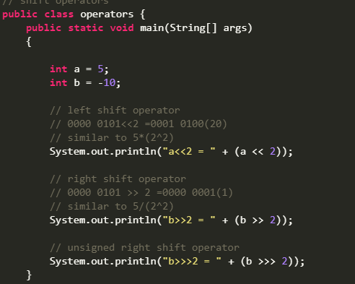
Example

Slide 32
Shift Operators
The Java left shift operator << is used to shift all the bits in a value to the left side of a specified number of times.
The Java right shift operator >> is used to move left operands value to right by the number of bits specified by the right operand.

Slide 33
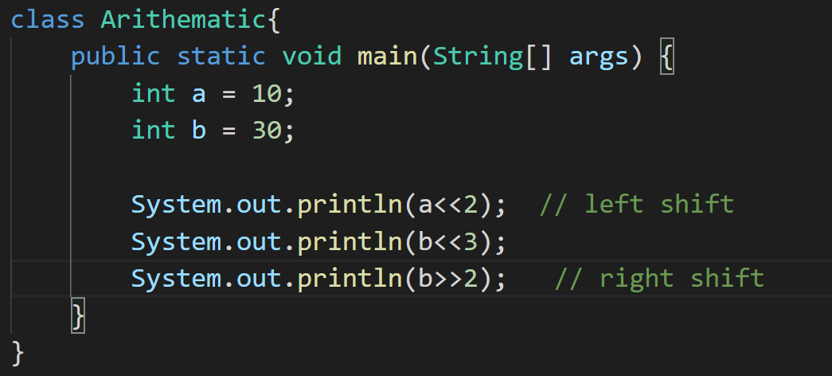
Example

